Slide 1
DEMAND PREDICTION
TEAM MEMBERS:
M.Ajith Kumar
A.Raj Kumar
S.Shanmugarajan
B.Sibiraj

Slide 2
AGENDA
Introduction
understand the problem
data collection and pre-processing
exploratory data analysis(EDA)
model selection
features importance
correlation
challenges and future trends
conclusion

Slide 3
Introduction
Start with an introduction explaining the importance of demand prediction in business and supply chain management.
Highlight how data science and machine learning techniques have revolutionized demand forecasting.

Slide 4
Understanding the Problem
Describe the challenges businesses face with demand prediction, such as seasonality, market trends, and fluctuations.
.Explain the significance of accurate demand prediction in optimizing inventory, reducing costs, and improving customer satisfaction.

Slide 5
Data Collection and Preprocessing
Discuss the types of data needed for demand prediction, such as historical sales data, market data, and external factors.
.Explain data preprocessing steps, including data cleaning, feature engineering, and dealing with missing values.

Slide 6
Exploratory Data Analysis (EDA)
Showcase the importance of EDA in gaining insights into the data, identifying patterns, and visualizing trends.
Provide examples of EDA techniques like time series decomposition, correlation analysis, and data visualization.

Slide 7
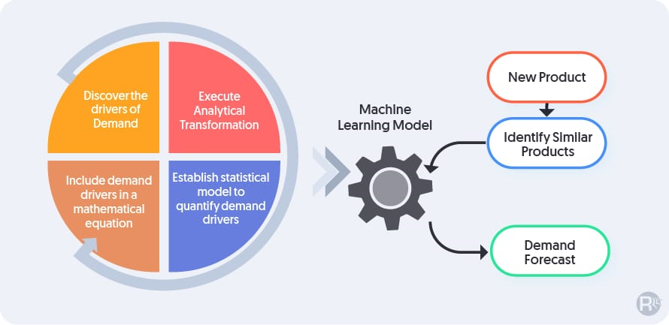
Model Selection
Introduce different machine learning and statistical models commonly used for demand prediction, such as linear regression, ARIMA, and machine learning algorithms like Random Forest or LSTM.
.Explain the strengths and weaknesses of each model.

Slide 8
Feature Importance
.Showcase methods like feature importance plots or permutation importance.
Explain the concept of feature importance in demand prediction models and how it helps in identifying influential factors.

Slide 9
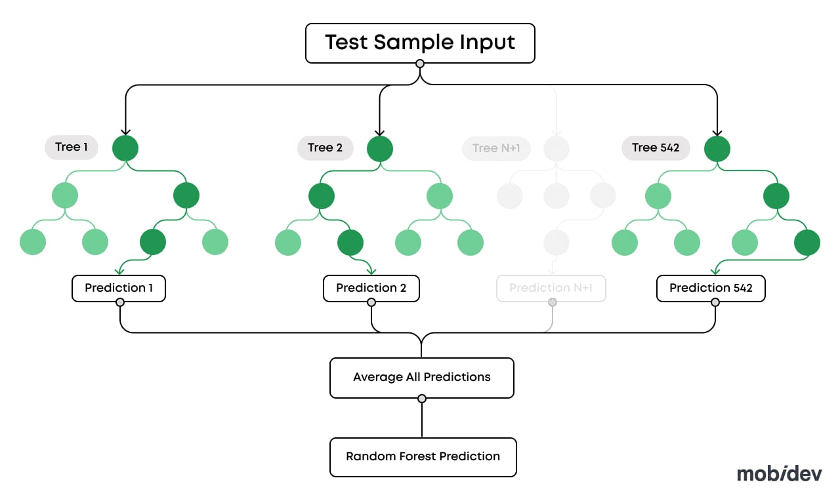
Correlation:
.Much like the harmonious notes in a symphony, correlation unveils the melodious interplay between variables. We'll explore how different factors dance together, determining whether they harmonize or clash.
. This harmonious or discordant relationship will shape our understanding of what drives product demand.

Slide 10
Challenges and Future Trends
Address the challenges in demand prediction, such as data quality issues and the need for real-time forecasting.
Discuss emerging trends like the use of deep learning, AI-driven demand forecasting, and the integration of IoT data.

Slide 11
Conclusion:
As our journey nears its end, we'll wrap up with a profound reflection. This is where we draw conclusions from our predictions, shedding light on the implications for businesses and industries.
We'll discuss the real-world applications of our insights, showcasing the transformative power of data-driven product demand prediction.

